Slide 1
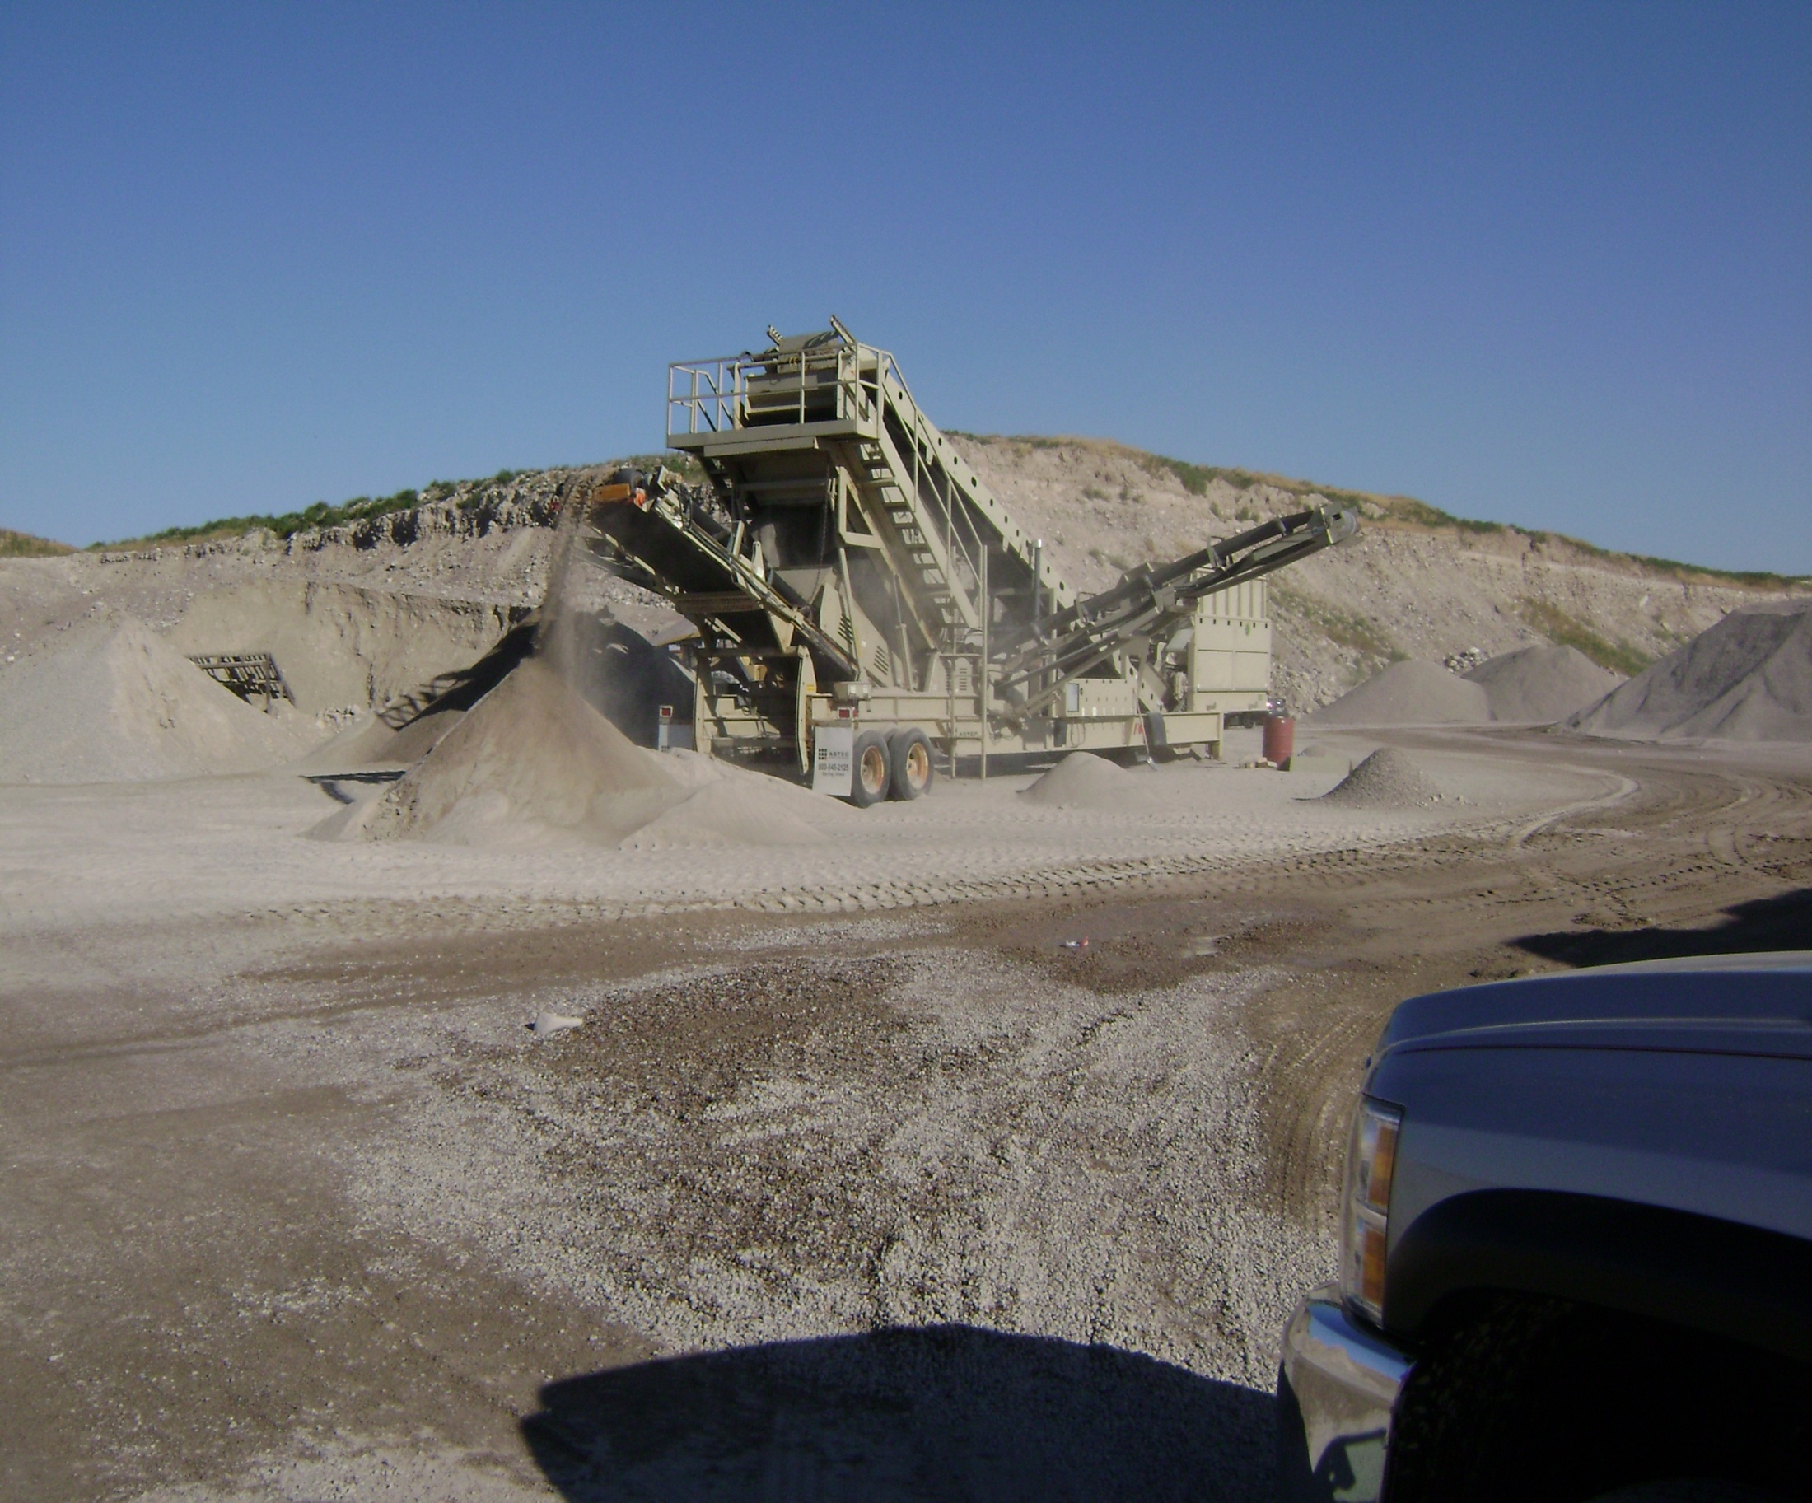
FOP for Test Method

Slide 2
Significance
Description of the Field Operating Procedure and possible uses
Notes:
Use this area for instructor notes
Additional slides and graphics may be added.

Slide 3
Scope
Statement containing the AASHTO reference and any qualifiers

Slide 4
Apparatus
Basic laboratory and disposable items will be listed in the FOP in detail. Major equipment specific to the test method may have a reference to the AASHTO procedure.

Slide 5
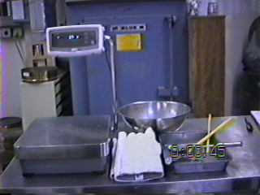
Required Equipment
Example of Equipment

Slide 6
Sample
Reference to how sample is obtained, reduced, etc.

Slide 7
Sample Preparation
Steps for sample prep if applicable (non-mandatory)

Slide 8
Procedure
Step-by-step instructions for performing the procedure
Sub-steps if applicable

Slide 9
Procedure (cont.)
Step-by-step instructions on performing the procedure (may be multiple slides)

Slide 10
Calculations (if applicable – example shown)
Constant Mass
$$\frac{M_{p}−M_{n}}{M_{p}}×100=\% \text{Change}$$
Where:
M_{p} = previous mass measurement
M_{n} = new mass measurement

Slide 11
Calculation Example
Show calculation(s) using numbers one may encounter in performing the procedure on a sample

Slide 12
Report
Information to be reported; include the required accuracy of any reported results
Notes:
Provide or show agency forms.

Slide 13
Tips!
Reminders of important steps, etc.

Slide 14
Q & A
Procedure name and number

