Slide 1
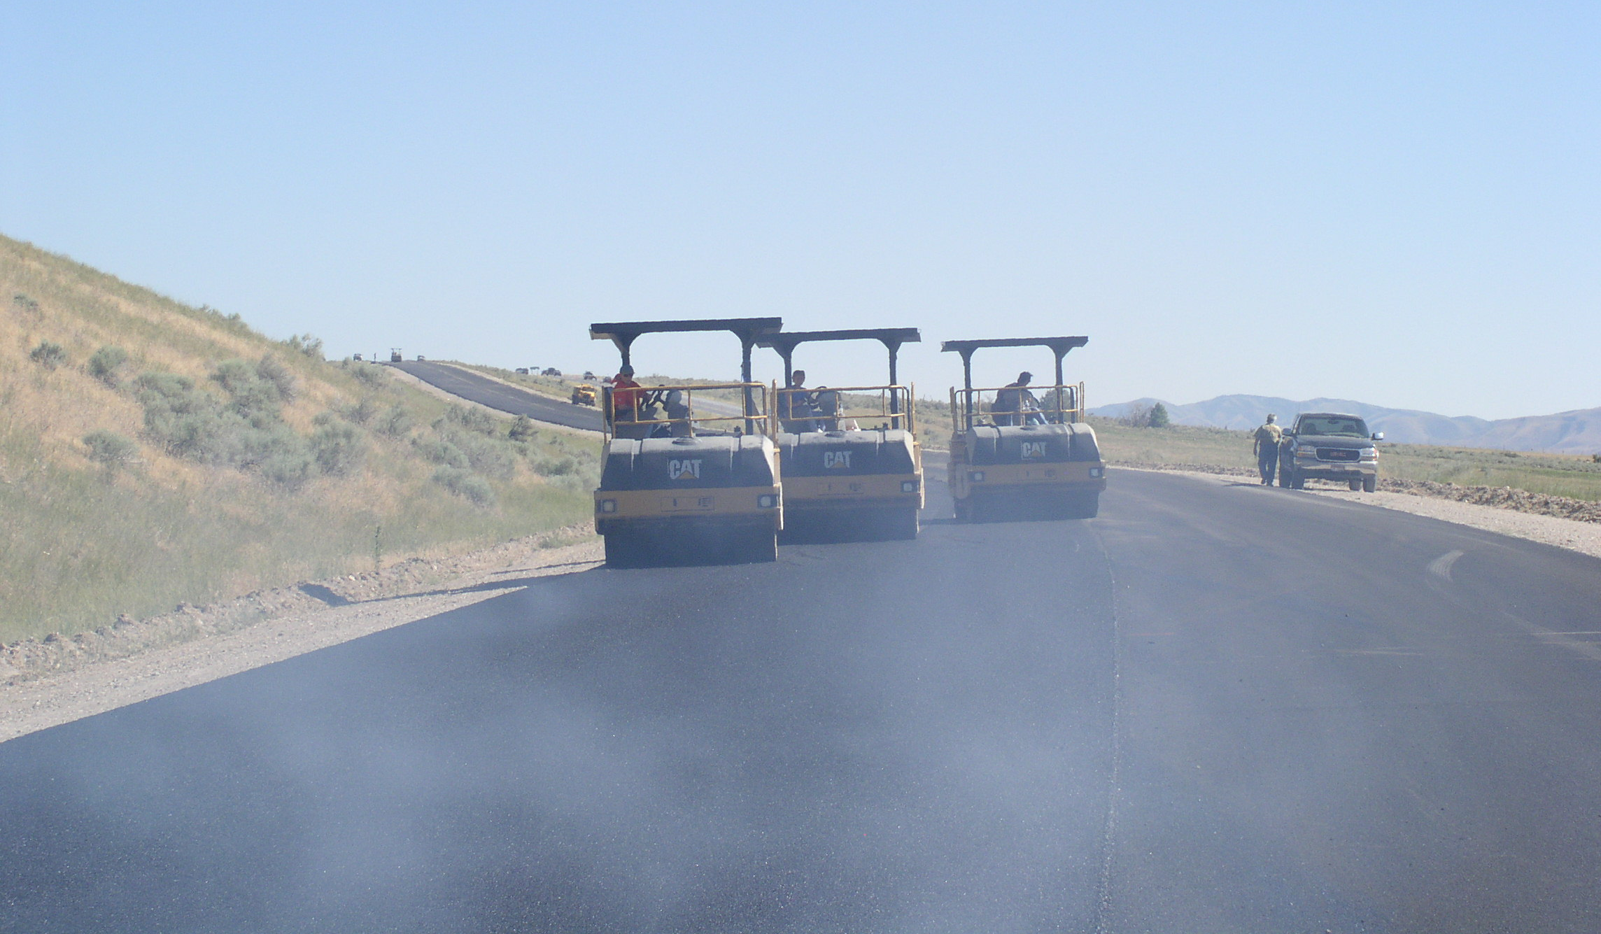

FOP for Test Method

Slide 2
Significance
Description of the Field Operating Procedure and possible uses
Notes:
Use this area for instructor notes
Additional slides and graphics may be added.

Slide 3
Scope
Statement containing the AASHTO reference and any qualifiers

Slide 4
Apparatus
Basic laboratory and disposable items will be listed in the FOP in detail. Major equipment specific to the test method may have a reference to the AASHTO procedure.

Slide 5
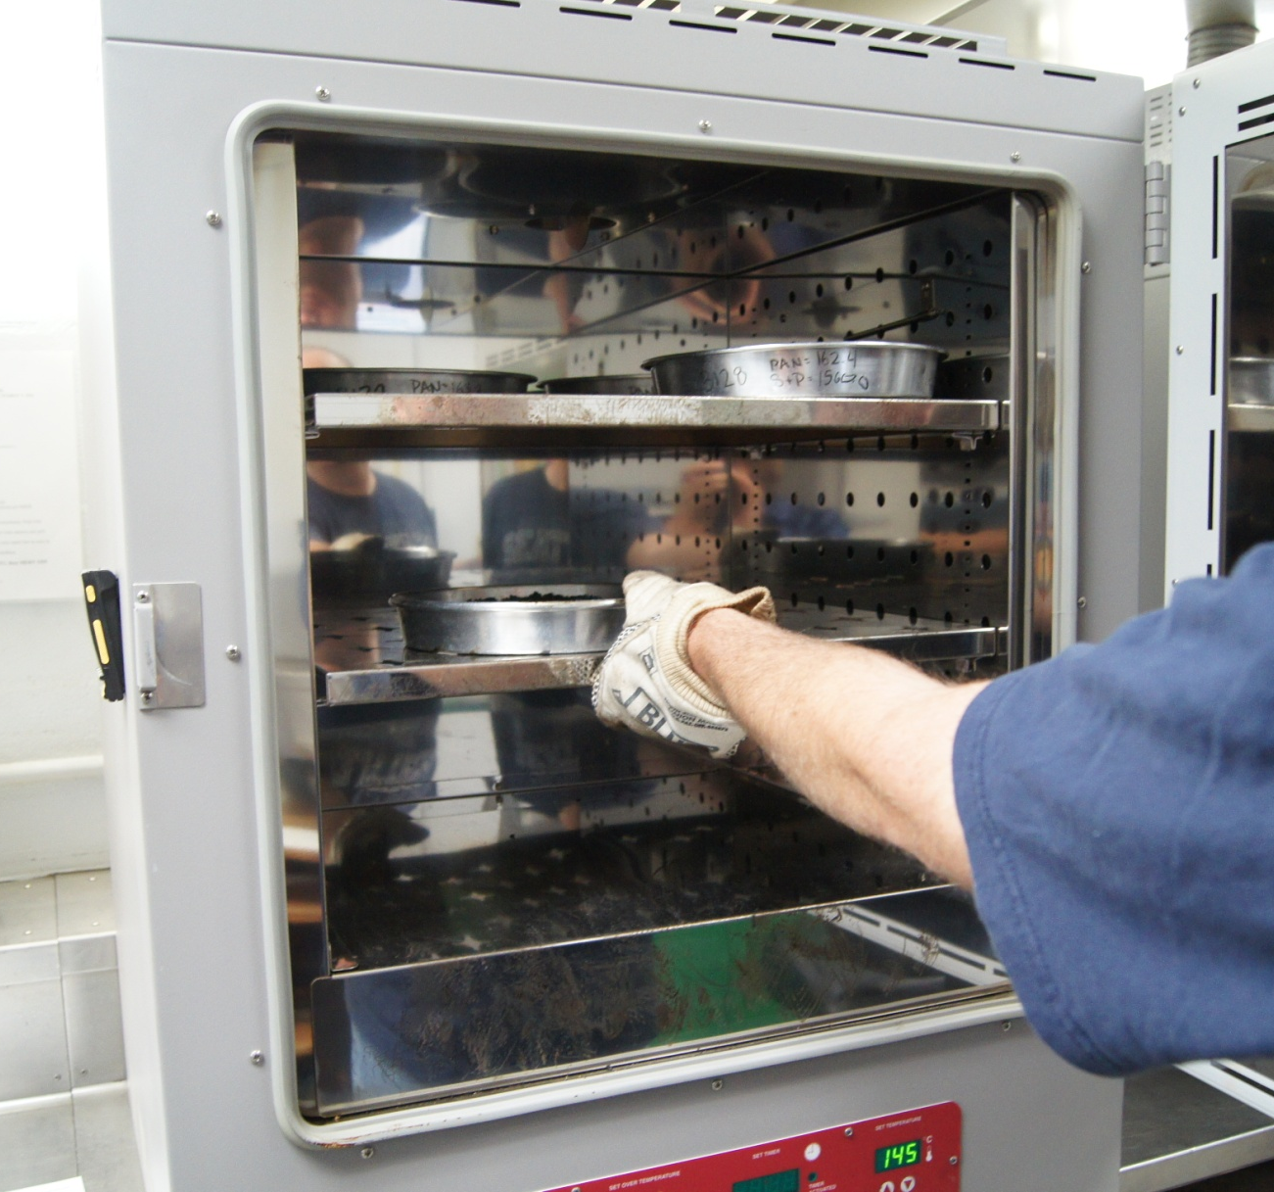
Apparatus
Example of apparatus

Slide 6
Sample
Reference to how sample is obtained, reduced, etc.

Slide 7
Sample Preparation
Steps for sample prep if applicable (non-mandatory)

Slide 8
Procedure
Step-by-step instructions for performing the procedure
  Sub-steps if applicable.

Slide 9
Procedure, cont.
Step-by-step instructions on performing the procedure (may be multiple slides)

Slide 10
Calculation (if applicable)
Insert equation and variables

Slide 11
Calculation Example
Show calculation(s) using numbers one may encounter in performing the procedure on a sample

Slide 12
Report
Information to be reported; include the required accuracy of any reported results
Notes:
Provide or show agency forms.

Slide 13
Tips!
Reminders of important steps, etc.

Slide 14
Q & A
Procedure name and number

