Slide 1
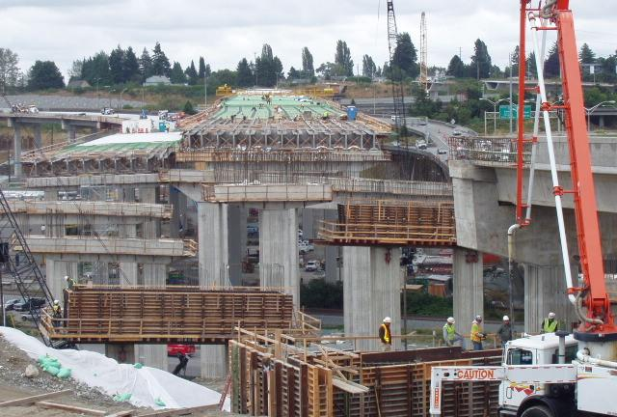
FOP for Test Method

Slide 2
Significance
Description of the Field Operating Procedure and possible uses
Notes:
Use this area for instructor notes
Additional slides and graphics may be added.

Slide 3
Scope
Statement containing the AASHTO reference and any qualifiers

Slide 4
Apparatus
Basic laboratory and disposable items will be listed in the FOP in detail. Major equipment specific to the test method may have a reference to the AASHTO procedure.

Slide 5
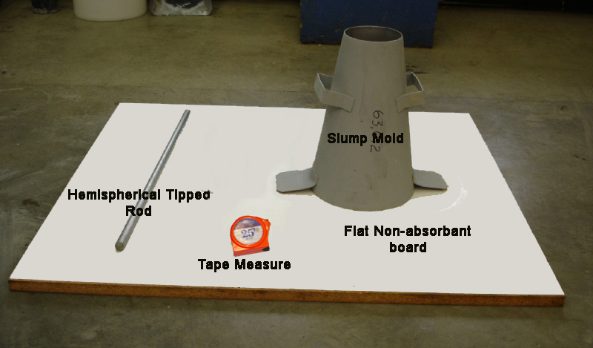
Example of Apparatus

Slide 6
Sample
Reference to how sample is obtain and/or prepared

Slide 7
Procedure
Step-by-step instructions for performing the procedure
Sub-steps if applicable

Slide 8
Procedure, cont.
Step-by-step instructions on performing the procedure (may be multiple slides)

Slide 9
Calculation (if applicable)
Insert equation and variables

Slide 10
Calculation Example
Show calculation(s) using numbers one may encounter in performing the procedure on a sample

Slide 11
Report
Information to be reported; include the required accuracy of any reported results
Notes:
Provide or show agency forms.

Slide 12
Tips!
Reminders of important steps, etc.

Slide 13
Q & A
Procedure name and number

